Slide 1

object-oriented programming
INTRODUCTION

Slide 2
BEFORE OBJECT-ORIENTED
BASIC
FORTRAN
COBOL
C Language
C++ (Object-Oriented)
JAVA
The main intention of Creating Java is “Platform Independent”

Slide 3
C LANGUAGE
?????

Slide 4
Contents
Object Oriented Thinking
Object-Oriented Principles
The First Program
The Java Buzz Words
An overview of Java

Slide 5
Object-Oriented Thinking
Agents and Communities
Messages and methods
Responsibilities
Classes and Instances
Class Hierarchies

Slide 6
Agents and Communities
An object oriented program is structured as a community of interacting agents, called objects. Each object has a role to play. Each object provides a service, or performs an action, that is used by other members of the community.
Example of florist

Slide 7
Messages and Methods
Action is initiated in object- oriented programming by the transmission of a message to an agent (an object) responsible for the action. The message encodes the request for an action and is accompanied by any additional information (arguments) needed to carry out the request.
The receiver is the object to whom the message is sent. If the receiver accepts the message, it accepts the responsibility to carry out the indicated action. In response to a message, the receiver will perform some method to satisfy the request.

Slide 8
Responsibilities
Fundamental concept in object-oriented programming is to describe behavior in terms of responsibilities.
By discussing a problem in terms of responsibilities we increase the level of abstraction. This permits greater independence between objects, a critical factor in solving complex problems. The entire collection of responsibilities associated with an object is often described by the term protocol.
Ask not what you can do to your data structures,
But rather ask what your data structures can do for you.

Slide 9
Classes and Instances
A class is a user defined blueprint or prototype from which objects are created. It represents the set of properties or methods that are common to all objects of one type.
All objects are instances of a class. The method invoked by an object in response to a message is determined by the class of the receiver. All objects of a given class use the same method in response to similar messages.

Slide 10
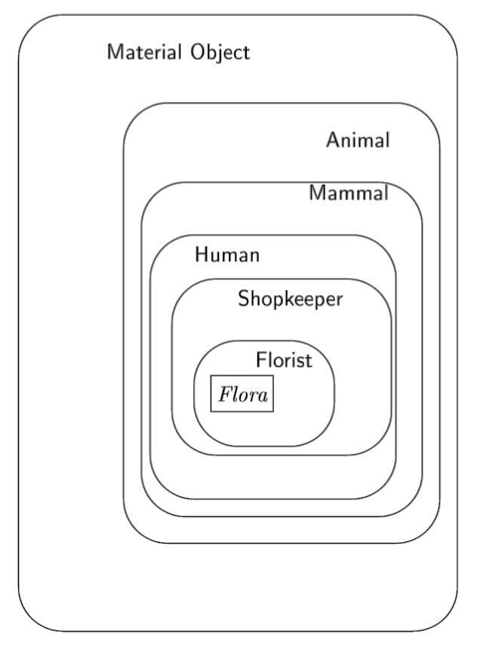
Class Hierarchies - Inheritance

Slide 11
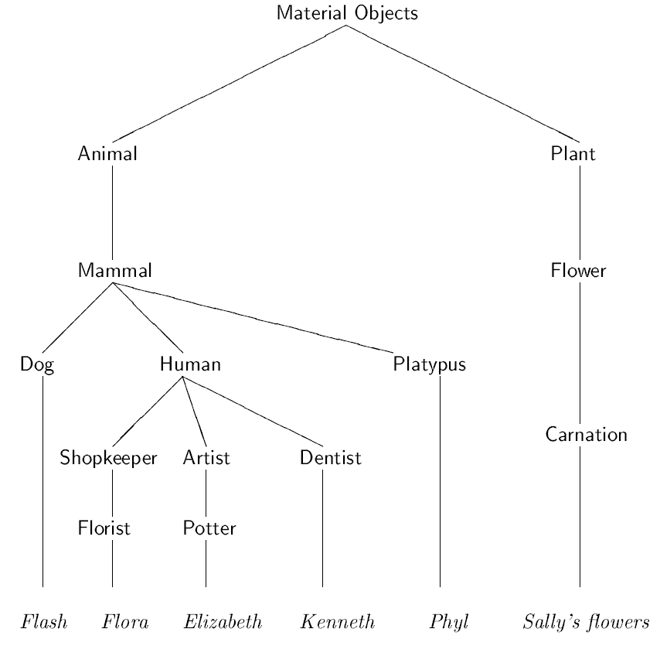
Class Hierarchies - Inheritance

Slide 12
Object-Oriented Principles
Class
Object
Abstraction
Encapsulation
Inheritance
Polymorphism
Message Passing

Slide 13
Abstraction
An essential element of object-oriented programming is abstraction.
The data from a traditional process-oriented program can be transformed by abstraction into its component objects.
A sequence of process steps can become a collection of messages between these objects.
Thus, each of these objects describes its own unique behavior.
You can treat these objects as concrete entities that respond to messages telling them to do something. This is the essence of object-oriented programming.

Slide 14
Encapsulation
Encapsulation is the mechanism that binds together code and the data it manipulates, and keeps both safe from outside interference and misuse.
One way to think about encapsulation is as a protective wrapper that prevents the code and data from being arbitrarily accessed by other code defined outside the wrapper.
In Java, the basis of encapsulation is the class.
Wrapping up of the data and code as a single piece.

Slide 15
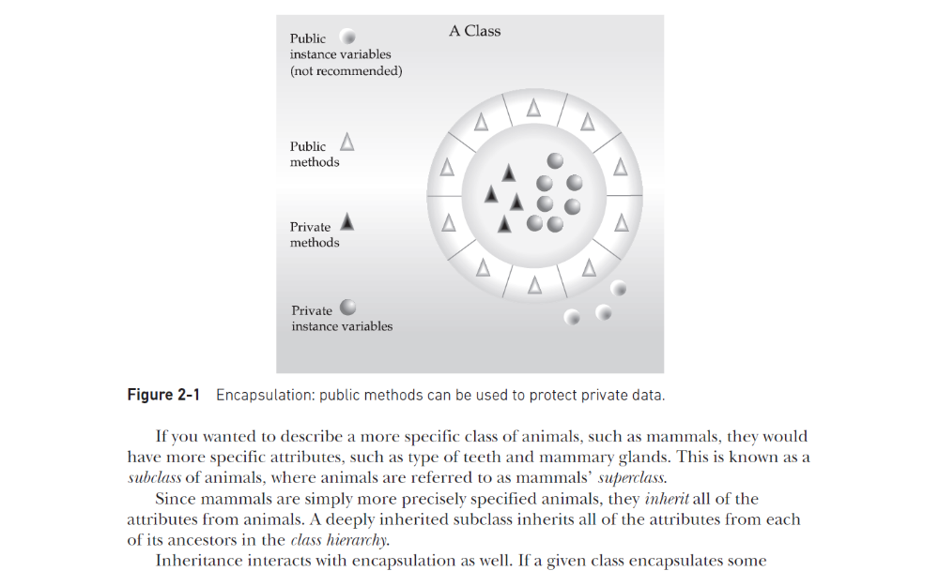
Encapsulation

Slide 16
Inheritance
Inheritance is the process by which one object acquires the properties of another object.
This is important because it supports the concept of hierarchical classification.
As mentioned earlier, most knowledge is made manageable by hierarchical (that is, top-down) classifications.

Slide 17
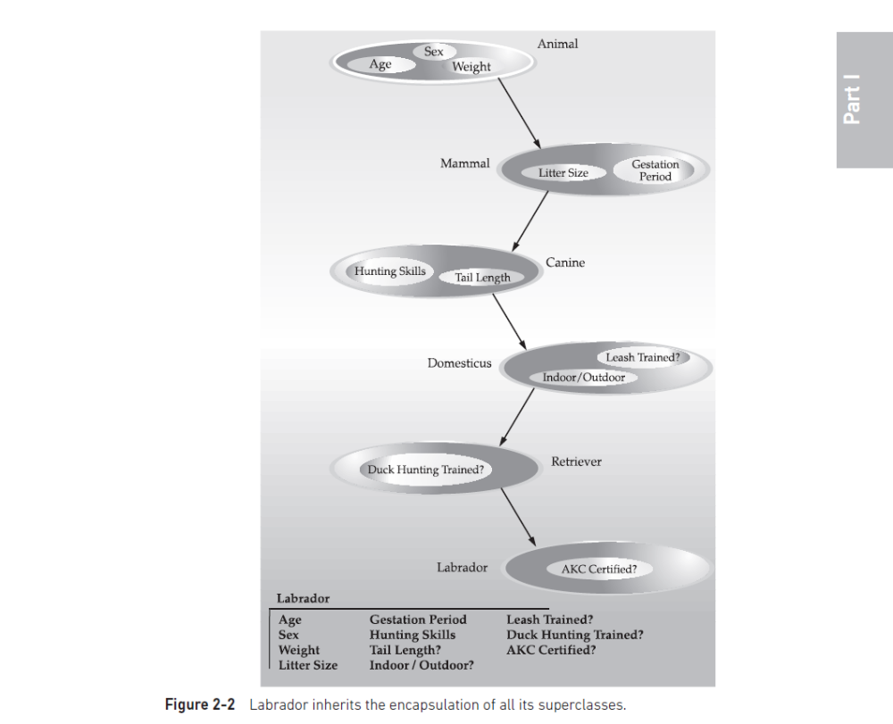
Inheritance

Slide 18
Polymorphism
Polymorphism (from Greek, meaning “many forms”) is a feature that allows one interface to be used for a general class of actions. The specific action is determined by the exact nature of the situation.

Slide 19
Message Passing
Message Passing is nothing but sending and recieving of information by the objects same as people exchange information. So this helps in building systems that simulate real life. Following are the basic steps in message passing.
Creating classes that define objects and its behavior.
Creating objects from class definitions
Establishing communication among objects
In OOPs, Message Passing involves specifying the name of objects, the name of the function, and the information to be sent.
Message passing again helps us to hide our data from different methods and objects

Slide 20
Sample Java Program
class FirstProgram{
public static void main(String[] s){
System.out.println(“Hello World!”);
}
}

Slide 21
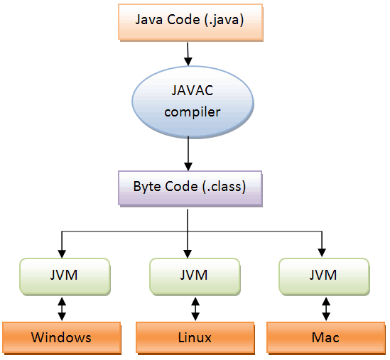
Compiling and Executing

Slide 22
Java Buzz Words
Simple
Secure
Portable
Object-Oriented
Robust
Multithreaded
Architecture-neutral (Platform-Independent)
Interpreted
High performance
Distributed
Dynamic

Slide 23
Data Types
Java is Strongly Typed (Strongly-Coupled) Language.

Slide 24
Primitive Data Types
Integers – byte, short, int and long
Floating-Point Numbers – float and double
Characters – char
Boolean – boolean

Slide 25
Integer
Name | Width | Range
long | 64 | –9,223,372,036,854,775,808 to 9,223,372,036,854,775,807
int | 32 | –2,147,483,648 to 2,147,483,647
short | 16 | –32,768 to 32,767
byte | 8 | –128 to 127

Slide 26
Floating-Point Numbers
Name | Width | Range
double | 64 | 4.9e–324 to 1.8e+308
float | 32 | 1.4e–045 to 3.4e+038

Slide 27
Integer Literals
base 10 numbers (Decimals), base 8 numbers (Octal) and 16 base numbers (Hexadecimal).
int bin = 0b1010; ----- Valid
int phno = 9000_188_956; ----- Valid (ignores underscores) Underscores can only be used to separate digits. They cannot come at the beginning or the end of a literal.
int phno = 9000___188___956; ---- Valid

Slide 28
Integer Literals
The use of underscores in an integer literal is especially useful when encoding such things as telephone numbers, customer ID numbers, part numbers, and so on. They are also useful for providing visual groupings when specifying binary literals. For example, binary values are often visually grouped in four-digits units, as shown here:
int num = 0b1101_0101_0001_1010;

Slide 29
Floating-Point Literals
double 0x12.2P2 represents double 72.5.
double num = 9_423_497_862.0; ---- Valid
double num = 9_423_497.1_0_9; ----- Valid

Slide 30
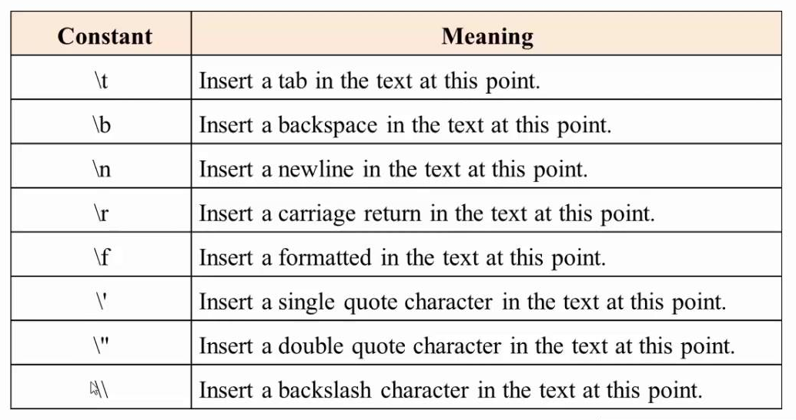
Escape Sequences

Slide 31
Variables
The variable is the basic unit of storage in a Java program.
A variable is defined by the combination of an identifier, a type, and an optional initializer.
type identifier [= value][, identifier [= value] … ];

Slide 32
Type Conversion and Casting
Java’s Automatic Conversions
Casting Incompatible Types

Slide 33
Arrays
An array is a group of like-typed variables that are referred to by a common name.
One-Dimensional Array
Multidimensional Array

Slide 34
Control Statements
Conditional
Looping

Slide 35
Conditional Statements
if
if-else
else-if Ladder
switch statement

Slide 36
Looping Statements
while
do-while
for

Slide 37
Introducing Classes
Object Class
Driver Class

Slide 38
Constructors
Initializes the state of new objects.
  class_name([parameterlist]) {
  statements;
  }
  Constructor should have the name same as that of class.
  runs when we use the new keyword
  no return type is specified;
  it implicitly "returns" the new object being created
  If a class has no constructor, Java gives it a default constructor with no parameters that sets all fields to 0.

Slide 39
Parameterized Constructors
public Point(int initialX, int initialY) {
x = initialX;
y = initialY;
}
public void translate(int dx, int dy) {
x += dx;
y += dy;
}
p1
x |  | y

Slide 40
Common constructor bugs
Re-declaring fields as local variables ("shadowing"):
  public Point(int initialX, int initialY) {
  int x = initialX;
  int y = initialY;
  }
  This declares local variables with the same name as the fields, rather than storing values into the fields. The fields remain 0.
2. Accidentally giving the constructor a return type:
  public void Point(int initialX, int initialY) {
  x = initialX;
  y = initialY;
  }
  This is actually not a constructor, but a method named Point

Slide 41
this Keyword
this can be used to refer current class instance variable.
this can be used to invoke current class method (implicitly)
this() can be used to invoke current class constructor.
this can be passed as an argument in the method call.
this can be passed as argument in the constructor call.
this can be used to return the current class instance from the method.

Slide 42
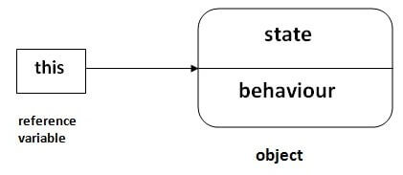
this Keyword

Slide 43
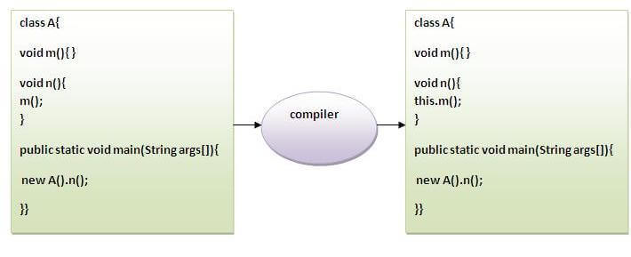
this Keyword

Slide 44
Overloading Methods
In Java it is possible to define two or more methods within the same class that share the same name, as long as their parameter declarations are different.
When this is the case, the methods are said to be overloaded, and the process is referred to as method overloading.
Method overloading is one of the ways that Java implements polymorphism.
When an overloaded method is invoked, Java uses the type and/or number of arguments as its guide to determine which version of the overloaded method to actually call.

Slide 45
Overloading Methods
Overloaded methods must differ in the type and/or number of their parameters.
While overloaded methods may have different return types, the return type alone is insufficient to distinguish two versions of a method.
When Java encounters a call to an overloaded method, it simply executes the version of the method whose parameters match the arguments used in the call.

Slide 46
Overloading Constructors
In addition to overloading methods, we can also overload constructors in java.
Overloaded constructor is called based upon the parameters specified when new is executed.
Sometimes there is a need of initializing an object in different ways.

Slide 47
Using Objects as Parameters
So far, we have only been using simple types as parameters to methods. However, it is both correct and common to pass objects to methods.

Slide 48
Access Control
Encapsulation links data with the code that manipulates it.
However, encapsulation provides another very important attribute: access control.
Through encapsulation, you can control what parts of a program can access the members of a class.
By controlling access, you can prevent misuse.
For example, allowing access to data only through a well-defined set of methods, you can prevent the misuse of that data.

Slide 49
Access Control
public
private
protected
default

Slide 50
static
There will be times when you will want to define a class member that will be used independently of any object of that class.
Normally, a class member must be accessed only in conjunction with an object of its class.
However, it is possible to create a member that can be used by itself, without reference to a specific instance.
This type of member is known as “static” member of the class.

Slide 51
static
Instance variables declared as static are, essentially, global variables.
Methods declared as static have several restrictions:
  They can only directly call other static methods.
  They can only directly access static data.
  They cannot refer to this in any way.

