Slide 1
Basic HTML tags

Slide 2
Structural Tags
<HTML>
These tags enclose the entire Web page document.
</HTML>
<HEAD>
These tags enclose the Head part of the document
</HEAD>
<TITLE>
These tags enclose the title of the document. This text appears in the title bar in the browser and on the bookmark list if someone bookmarks your web page.
</TITLE>

Slide 3
Sample Structure of a Web Site
<HTML>
<HEAD>
<TITLE> John Q. Public's Web Page </TITLE>
</HEAD>
<BODY>
This is John Public's Webpage!
</BODY>
</HTML>

Slide 4
Header Tags
Header Tags -- Used for marking sections and subsections in a document.
<H1>Header 1 -- Giant-sized and bold </H1>
<H2>Header 2 -- Large and bold </H2>
<H3>Header 3 -- Normal-sized and bold </H3>
<H4>Header 4 -- Small and bold </H4>
<H5>Header 5 -- Very Small and bold </H5>
<H6>Header 6 -- Tiny and bold </H6>

Slide 5
Header Tags (cont.)
H1 = Giant-sized and bold
H2 = Large and bold
H3 = Normal-sized and bold
H4 = Small and bold
H5 = Very Small and bold
H6 = Tiny and bold

Slide 6
Breaking Lines and Paragraphs
<P> text </P>
  Paragraph tag
  Most browsers render (process) this with blank lines between each paragraph
<BR>
  Line break tag
  Used when the webmaster wants a carriage return but doesn't want a blank line to follow
Example: text a
<p>text a</p>
<p>text b</p> text b
<br>text c
<br>text d text c
text d

Slide 7
Horizontal Rule
The <HR> tag puts a graphical line across the page.
Ex:
Horizontal Rule Attributes:
NOSHADE -- A solid line with no shading
WIDTH="xx%/xx" -- Controls the width of the line. You may specify either percentage of the width of a page or actual pixel length
SIZE="xx" -- Controls the height of the line. You need to specify the
dimension in pixels.
ALIGN="left/center/right" -- This allows the line to be aligned to the left,
right, or center of the page

Slide 8
Text Formatting Tags
Some basic text formatting styles:
Tag Result
<I> Italics </I> Italics
<B> Bold </B> Bold
<PRE> Preformatted Text </PRE> Preformatted Text
<STRONG> Strong </STRONG> Strong
<ADDRESS> Address </ADDRESS> Address
<CITE> Citations </CITE> Citations
<CODE> Source Code </CODE> Source Code

Slide 9
Font modifications
Web creators can also change the way text looks by using the <FONT> tag
SIZE="number" - changes size of the font; 1=smallest, 7 = largest
<FONT SIZE="7">Big</FONT> <FONT SIZE="1">Small</FONT>
Big Small
COLOR="color-name" - changes text color
<FONT COLOR="red">This is red</FONT>
This is red
FACE="font-name" - changes font
<FONT FACE="verdana">This is the verdana font;</FONT> <FONT FACE="chicago">this is the chicago font.</FONT>
This is the verdana font; this is chicago font.

Slide 10
<Font> modifications (cont.)
One can combine font modifications:
<FONT SIZE="7" FACE="courier" COLOR="red">Big, Courier & Red</FONT>
Big, Courier & Red
<FONT SIZE="7"><FONT FACE="courier">Big & Courier</FONT> - Just Big</FONT>
Big & Courier - Just Big

Slide 11
Lists -- Unordered Lists
Unordered lists:
<UL>
<LI>Item One<LI>
<LI>Item Two<LI>
<LI>Item Three<LI>
<LI>Item Four<LI>
</UL>
Item One
Item Two
Item Three
Item Four
Unordered List Attributes:
  type="disc/circle/square"
  Disc (default) ○ Circle  Square

Slide 12
Lists -- Ordered Lists
Ordered (Numbered) Lists:
Ordered List Attributes:
<OL>
<LI> Item One</LI>
<LI> Item Two</LI>
<LI> Item Three</LI>
<LI> Item Four</LI>
</OL>
1. Item One
2. Item Two
3. Item Three
4. Item Four
type="i/I/a/A/1" (default)
i = i. Item One I = I. Item One a = a. Item One A = A. Item One 1 = 1.Item One
ii. Item Two II. Item Two b. Item Two B. Item Two 2. Item Two
iii. Item Three III. Item Three c. Item Three C. Item Three 3. Item Three
iv. Item Four IV. Item Four d. Item Four D. Item Four 4. Item Four
start="xx"
  This attribute lets you specify which number/letter will start the list

Slide 13
Lists -- Definition Lists
Definition Lists:
<DL>
<DT>List Name One
<DD>This is where information about List Name One would go</DD>
</DT>
<DT>List Name Two
<DD>This is where information about List Name Two would go</DD>
</DT>
</DL>
List Name One
This is where information about List Name One
would go
List Name Two
This is where information about List Name Two
would go

Slide 14
Links
The anchor tag <A> is used to link one document to another or from one part of a document to another part of the same document.
Basic Links:
<A HREF="http://www.stanford.edu/">Stanford University</A>
Inter-document Links:
<A HREF="#spot">Point to 'spot' in this document</A>
Defining a point in a document:
<A NAME="spot">Spot</A>
Email links:
<A HREF="mailto:someone@somehost.com">Email someone@somehost.com</A>

Slide 15

Images
To have a graphic appear on a webpage, web designers must to put the <IMG> tag in with the address where the graphic "lives":
<IMG SRC="http://www.someplace.com/images/fish.gif">

Slide 16
Images (contd.,)
Graphics attributes:
alt="text": insert a description of the graphic for those who are using browsers that cannot
process images (e.g., page readers for the blind)
width="xx/xx%": width in pixels/percentage
height="xx/xx%": height in pixels/percentage
border="xx": pixel length of the border surrounding the image.
hspace="xx": places a buffer of space horizontally around the image
vspace="xx": places a buffer of space vertically around the image
align="top/middle/bottom/right/left": aligns image in relation to the text (see next 2 slides)

Slide 17
Images (cont.)
<img src="http://www.someplace.com/images/fish.gif" align="top">All about Fish
<img src="http://www.someplace.com/images/fish.gif" align="middle">All about Fish
<img src="http://www.someplace.com/images/fish.gif" align="bottom">All about Fish
All about Fish
All about Fish
All about Fish

Slide 18
Images (cont.)
<img src="http://www.someplace.com/images/fish.gif" align="left">
<img src="http://www.someplace.com/images/fish.gif" align="right">

Slide 19
Table Tag
Graphical tables are enclosed within a two-sided <table> tag that identifies the start and ending of the table structure.
Each row of the table is indicated using a two-sided <tr> (for table row).
Within each table row, a two-sided <td> (for table data) tag indicates the presence of individual table cells.

Slide 20

The General Table Syntax
  <table>
  <tr>
  <td> First Cell </td>
  <td> Second Cell </td>
  </tr>
  <tr>
  <td> Third Cell </td>
  <td> Fourth Cell </td>
  </tr>
  </table>
two rows
two columns

Slide 21
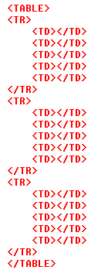
HTML Structure of a Table
beginning of the table structure
table cells
HTML provides the <th> tag for table headings.
Text formatted with the <th> tag is centered within the cell and displayed in a boldface font.
The <th> tag is most often used for column headings, but you can use it for any cell that you want to contain centered boldfaced text.
first row of six in the table
end of the table structure

Slide 22
Creating Headings with the <th> Tag
HTML provides the <th> tag for table headings.
Text formatted with the <th> tag is centered within the cell and displayed in a boldface font.
The <th> tag is most often used for column headings, but you can use it for any cell that you want to contain centered boldfaced text.

Slide 23
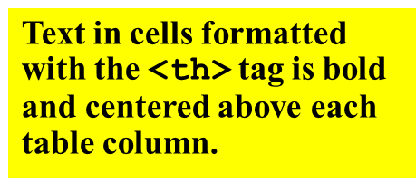
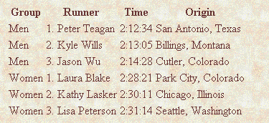
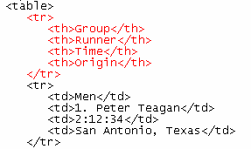
Adding Table Headings to the Table
table headings

Slide 24
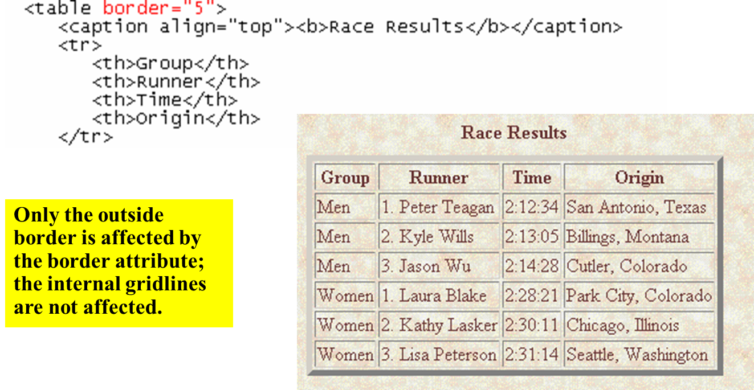
Adding a 5-Pixel Border to a Table along with Caption

Slide 25
HTML Forms
The FORM tag is used to create a data input form.
A region using forms is enclosed within the <FORM> </FORM> tags.
A document can have several forms, but the forms should not be embedded.
The FORM tag has four attributes:
  NAME, ACTION, METHOD, and ENCTYPE.

Slide 26
Forms
METHOD:
  Specifies the way in which the data from the user are encoded.
  The default METHOD is GET, although the POST method is preferred.
  GET: The CGI program receives the encoded form input in the QUERY_STRING variable, which follows the “?” in the URL that calls the script.
  POST: The CGI script or program receives the encoded form input in its standard input stream. The CONTENT_LENGTH must be used.

Slide 27
Forms
ACTION:
  Specifies the destination URL to which the form should be submitted, once it has been completed by the user.
  If no URL is specified, the URL of the current document containing the form is used.
  MAILTO Action: The data from the form is mailed to the specified E-mail address. Use the POST method.

Slide 28
Forms
ENCTYPE:
  Tell the browser how the data from a form should be encoded when it is returned to the server.
  The default is “application/x-www-form-urlencoded” that converts spaces to “+” and uses “&” to delineated different data fields.

Slide 29
Form Tag
<Form Action=“getemp.asp” Method=“post”>
(all form elements inside)
</Form>

Slide 30
Forms
Form Input: INPUT
  Only used within a FORM element and is denoted by <INPUT>.
  Attributes:
    NAME: The name of the particular element.
    MAXLENGTH: The maximum number of characters that can be entered by users in a text field.
    SIZE: Specifies the size of the field and depends on its type.
    SRC: Denote URL for an image.
    VALUE: Contain the initial value displayed to users.
    TYPE: Defines the type of data used in the field.
    CHECKED: Indicates that a checkbox or radio button is selected.
    DISABLED: Prevents the field from receiving focus.
    ALIGN: Alignment if image is used.
    READONLY: Prevents modification of the contents of the field.

Slide 31
TYPE Attribute
TEXT type:
  Specifies a single line text entry field.
  Can be used with the MAXLENGTH and SIZE attributes (MAXLENGTH >= SIZE)
  <P><B> First Name:</B> <INPUT NAME=“fname” TYPE=“text” MAXLENGTH = “30” SIZE = “30”></P>
  <P><B> Last Name:</B> <INPUT NAME=“lname” TYPE=“text” MAXLENGTH=“30” SIZE=“30”></P>

Slide 32
TYPE Attribute
PASSWORD Type:
  Same as text except the text entered by the user is obscured.
  Use the MAXLENGTH and SIZE attributes.
  <P><B> Enter Your Password:</B>
  <INPUT NAME=“password” TYPE=“password” MAXLENGTH=“30” SIZE =“30”></P>

Slide 33
TYPE Attribute
Checkbox:
  An object where several values can be selected at the same time.
  The checkbox is submitted as separate name/value pair for each selected value.
  Checkbox that are grouped together should have
    a different name.
    a unique value.

Slide 34
TYPE Attribute
Example:
  <FORM>
  What pets do you own?
  <P><INPUT TYPE=CHECKBOX name = petdog value=“dog”> DOG
  <BR><INPUT TYPE=CHECKBOX name = petcat value=“cat”> CAT
  <BR><INPUT TYPE=CHECKBOX name = petbird value=“bird”> BIRD
  <BR><INPUT TYPE=CHECKBOX name = petfish value=“fish”> FISH
  </FORM>

Slide 35
TYPE Attribute
Radio Boxes:
  An object that defines an item where only one value can be selected from a set of possibilities.
  A set is defined as the group of radio boxes with the same NAME attribute.
  Never set more than one radio box at a time with the CHECKED attribute.
  <P><B>Charge Card:</B>
  <INPUT NAME = “cc” VALUE=“visa” TYPE = “radio”>VISA
  <INPUT NAME = “cc” VALUE=“mc” TYPE = “radio”>Master Card
  <INPUT NAME = “cc” VALUE=“amex” TYPE = “radio”>American Express

Slide 36
TYPE Attribute
HIDDEN Type:
  When this type is chosen, no field is presented to the user.
  Primary use is record keeping for programs that may parse user input from forms.
  May be used for shopping carts.

Slide 37
TYPE Attribute
SUBMIT and RESET Types:
  SUBMIT: Used to submit the form’s content, as specified by the ACTION attribute.
  RESET: Set all fields in the form to their initial values.
  <P>INPUT TYPE=SUBMIT>
  <INPUT TYPE=RESET>
  <P><INPUT TYPE=SUBMIT VALUE = “Place Your Order”>
  <INPUT TYPE=RESET VALUE = “Start over”>

Slide 38
TYPE Attribute
BUTTON Input Type:
  Creates a button whose use can be defined through scripting and onClick event.
  Use to create a back button.
  Only useful to browsers that support scripting.
  <FORM><P><INPUT TYPE=“button” VALUE=“Back to Last Document” onClick=“history.back()”></P></FORM>

Slide 39
TEXTAREA
Let users enter more than one line of text.
Uses attributes ROWS and COLS to size.
WRAP Attribute:
  OFF: No wrapping
  VIRTUAL: Display wraps but long lines are sent as one line.
  PHYSICAL: Word wraps and text is sent with wrap points.

Slide 40
Drop Down Menu
Use SELECT and OPTION to create Drop down menu.
SELECT:
  Allows the user to choose one (or possibly more) items from a list.
  Attributes: MULTIPLE, SIZE, and NAME.
OPTION:
  Specifies the list items.
  Attributes: SELECTED, VALUE, and LABEL

Slide 41
Drop Down Menu
Example:
  <P><B>Pick your favorite baseball team:</B>
  <BR><SELECT NAME=“team”>
  <OPTION>Dodgers</OPTION>
  <OPTION>Braves</OPTION>
  <OPTION>Cardinals</OPTION>
  <OPTION>Yankees</OPTION>
  </SELECT>

Slide 42
Cascading Style Sheets
C S S

Slide 43
What is CSS?
A simple mechanism for controlling the style of a Web document without compromising its structure.
It allows you to separate visual design elements (layout, fonts, colors, margins, and so on) from the contents of a Web page.
Allows for faster downloads, streamlined site maintenance, and global control of design attributes across multiple pages.

Slide 44
CSS vs. just HTML
What can we do with CSS that we can’t do with HTML?
  Control of backgrounds.
  Set font size to the exact height you want.
  Highlight words, entire paragraphs, headings or even individual letters with background colors.
  Overlap words and make logo-type headers without making images.
  Precise positioning.
  Linked style sheets to control the look of a whole website from one single location.
  And more.

Slide 45
How to write CSS?
Selector
  HTML element tags
  (examples: p, h2, body, img, table)
  class and ID names
Property (examples: color, font-size)
Value (examples: red, 14pt)

Slide 46
How to write CSS:
The basic syntax of a CSS rule:
selector {property 1: value 1; property 2: value 2}
Example:
p {font-size: 8pt; color: red}
Notice the { } around the rule and the : before each value!

Slide 47
Three ways to include CSS:
Local (Inline)
Global (Embedded, or Internal)
Linked (External)

Slide 48
1. Local
Inline style sheet.
Placed inside tags.
Specific to a single instance of an html tag on a page.
Must be used instead of <font> tags to specify font size, color, and typeface and to define margins, etc.
Use to override an external or embedded style specification.

Slide 49

Local (inline)
Example
  <p style="font-size: 10pt; color: red; font-weight: bold; font-family: Arial, Helvetica, sans-serif">
  This is a local stylesheet declaration. </p>
On the browser:

Slide 50
2. Global
Embedded or internal style sheet
Applicable to an entire document
Styles are defined within the <style> </style> tag, which is placed in the header of the html file (i.e., within <head> and </head>).

Slide 51
Global (Internal)
Example:
  <html>
  <head>
  <title>Title</title>
  <style type="text/css">
  <!--[STYLE INFORMATION GOES HERE] -->
  </style>
  </head>
  <body>
  [DOCUMENT BODY GOES HERE]
  </body>
  </html>

Slide 52
3. Linked
External style sheet
Styles are saved in a separate file, with the extension .css
This single stylesheet can be used to define the look of multiple pages.

Slide 53
Linked (External)
Example
Save this text file as whatever.css
In TextPad,Notepad, etc.…
  p {font-family: verdana, sans-serif; font-size: 12pt; color: red}
  h1 {font-family: serif; font-size: 14pt; color: green}
  h2 {font-family: serif; font-size: 11pt; color: blue}

Slide 54
Linked (External)
Example (continued)
To apply the stylesheet “whatever.css“ to an HTML document, call it in from the header:
  <head>
  <link rel="stylesheet" href=“whatever.css" type="text/css">
  </head>

Slide 55
Inheritance: which style prevails when several are present?
Inline (local) overrides internal (global)
Internal (global) overrides external (linked).

Slide 56
Cascading
The way styles will be used when there is more than one style specified for an HTML element:
Browser default
External Style Sheet (Linked) (in an external .css file)
Internal Style Sheet (Global, or embedded) (inside the <head> tag)
Inline Style (Local) (inside HTML element)
An inline style (inside an HTML element) has the highest priority, which means that it will override every style declared inside the <head> tag, in an external style sheet, and in the browser (default value).

Slide 57
Let’s try this now!
  <h1 style=“text-align: center; font-weight:bold; color: blue”> Styling with CSS! </h1>
  <p style="font-size: 10pt; color: red; font-weight: bold; font-family: Arial, Helvetica, sans-serif“ >
  Write whatever you want here </p>

Slide 58
Grouping properties
Separate properties with a semi-colon
  Example:
p {text-align:center;color:red; font- family:Arial; font-style:italic}

Slide 59
Grouping selectors
Separate selectors with a comma
  Example:
h1,h2,h3,h4,h5,h6 { color: green }
(each header will be green)
Separate selectors with a space
  Example:
p li { color: red }
(only items within a list and a paragraph tag will be red)

Slide 60
The class Selector
With a class selector you can define different styles for the same type of HTML element
Examples:
First define the class:
  p.right {text-align: right; color: red; font-style: italic}
  p.blue {text-align: center; color:blue}
Then use the class in your HTML code :
  <p class="right"> This paragraph will be right-aligned, italic, and red. </p>
  <p class=“blue"> This paragraph will be center-aligned and blue. </p>

Slide 61
The class Selector
You can also omit the tag name in the selector to define a style that will be used by all HTML elements that have this class.
Example:
.poem {text-align: center; font-style:italic}
Any HTML element with class=“poem" will be center-aligned and italic.

Slide 62
The class Selector
Example (continued)
Both elements below will follow the rules in the ".poem“ class:
  <h1 class=“poem"> This heading will be center-aligned and italic </h1>
  <p class=“poem"> This paragraph will also be center-aligned and italic. </p>

Slide 63
Class Example
<style>
p {font-family: sans-serif; font-size: 10pt}
h1 {font-family: serif; font-size: 30pt}
h2 {font-family: serif; font-size: 24pt}
.boldred {color: red; font-weight: bold}
.green {color: green}
.tinyblue {color: blue; font-size: 8pt}
</style>
The tags and classes can then be used in combination:
<h1 class=“boldred">This is rendered as 30-point red serif bold text.</h1>
<p class=“boldred">This is rendered as 10-point red sans-serif bold text.</p>

Slide 64
Applying styles to portions of a document:
<div>
  A division tag: to “package” a block of document into one unit. It defines a block element.
  Causes a line break, like <br> and <p>.
<span>
  “Wraps” a portion of text into a unit, but doesn't cause a line break. Allows styles to be applied to an 'elemental' region (such as a portion of a paragraph).

Slide 65
Example
<p><span class="foo">This text is rendered as foo-style</span> and this is not. </p>
<div class="foo">
<p>The "foo" style will be applied to this text, and to <a href="page.html">this text</a> as well.
</div>

Slide 66
List of style Selectors and their Properties and Values:
From WDG:
http://www.htmlhelp.com/reference/css/properties.html

Slide 67
Properties - Font
font-family
  Name, or serif, sans-serif, cursive, monospace
font-style
  normal, italic
font-weight
  normal, bold, 100, 200, 300, 400, 500, 600, 700, 800, 900
font-size
  absolute-size, relative-size, length, percentage
font-variant
  small-caps

Slide 68
Properties - Text
text-decoration
  underline, line-through
text-transform
  capitalize, uppercase, lowercase, none
text-align
  left, right, center, justify
text-indent
  <length>, <percentage>

Slide 69
Properties - Position
position
  absolute, relative
top
  <length>, <percentage>, auto
left
  <length>, <percentage>, auto
Z-index
  <number>, auto

